Slide 1
Automated Pathology Registry for Chest X Ray Project Update Aug 4th , 2023

Slide 2
Agenda for Discussion
Project Dashboard Snapshot
Process Flow as it is happening
Step by Step Process Visuals Received/Activities Completed)
Sample Report Formats
Other Update & Next Steps

Slide 3
Project progress Snapshot
X-Ray Chest PA/AP Views ( 10 Pathologies) |  | Data Required by VT On Day/Date |  |  |  | Made Available to VT
 |  | 0 | 30 | 60 | 90
Sr. No. | Pathology | 01.04.2023 | 15.05.2023 | upto 9th july | 1st july to 30th july | 25.04.2023 | 31.05.2023 | 02.06.2023 | 12.06.2023 | 16.06.2023 | 10.07.2023 | 13.07.2023 | 16.07.2023 | 02.08.2023 |  |  |  |  |  |  |  |  |  |  |  | TOTAL | 1st Iteration | Estimation
1 | Normal Chest X-Ray | 10000 | 0 |  | 5000 | 5000 |  | 5000 |  |  |  |  |  | 15000 |  |  |  |  |  |  |  |  |  |  |  | 25000
2 | Consolidation | 5000 | 2500 |  | 2500 |  | 5000 |  | 500 |  |  |  |  |  |  |  |  |  |  |  |  |  |  |  |  | 5500 | Done
3 | Cardiomegaly | 5000 | 2500 |  | 2500 | 750 | 5000 |  |  |  |  |  |  |  |  |  |  |  |  |  |  |  |  |  |  | 5750 | Done
4 | Hilar Prominance | 5000 | 2500 |  | 2500 |  |  | 5000 |  | 2000 |  |  |  |  |  |  |  |  |  |  |  |  |  |  |  | 7000 | Done
5 | Blunted CP angle | 5000 | 2500 |  | 2500 |  | 5000 |  |  | 500 |  |  |  |  |  |  |  |  |  |  |  |  |  |  |  | 5500 |  | 15/08/2023 - 20/08/2023
6 | Fibrosis |  |  | 5000 | 2500 |  |  |  |  |  |  |  | 2000 |  |  |  |  |  |  |  |  |  |  |  |  | 2000
7 | Pleural Effusion (Pulmonary Consolidation) |  |  | 5000 | 2500 |  |  |  |  |  | 5000 |  |  |  |  |  |  |  |  |  |  |  |  |  |  | 5000 | WIP | 28/07/2023 - 18/08/2023
8 | Pneumothorax |  |  | 5000 | 2500 |  |  |  |  |  |  |  | 3000 |  |  |  |  |  |  |  |  |  |  |  |  | 3000
9 | GGO /if not available wil go for other pathology suggest by animesh sir |  |  | 5000 | 2500 |  |  |  |  |  |  |  |  |  |  |  |  |  |  |  |  |  |  |  |  | 0
10 | Lung Mass |  |  | 5000 | 2500 |  |  |  |  |  |  |  | 4000 |  |  |  |  |  |  |  |  |  |  |  |  | 4000
11 | Nodule <3 cm in diameter |  |  | 5000 | 2500 |  |  |  |  |  |  |  | 5000 |  |  |  |  |  |  |  |  |  |  |  |  | 5000 |  | 20/08/2023 - 01/09/2023

Slide 4
Process as it is happening
Model Deployment
Model Deployment
Model Testing
Model Optimization & Selection
X Ray Images are uploaded for Project
Pathology by Pathology X-Rays images are picked
Images are pushed for AI Modeling for Ist iteration
Multiple Models of AI will be deployed (Proprietary + Open Source)
AI Models trained with 80 % of available Images
AI Models are Tested/validated with balance 20 % Images
AI Model with Best Accuracy Level is Selected to proceed
Start
Output from Selected AI Model is Pushed to Dashboard
Output would be available in another production Server for parallel validation by Radiologist
Validation and feedback format for parallel Validation under WIP
Ongoing Cycle
- Image with Report in template finalized. Selection and Finalization of Report Template is WIP (c ).
Specification of Server Required:
T4 GPU
8/16 Cores
32 GB
Yet to Start

Slide 5
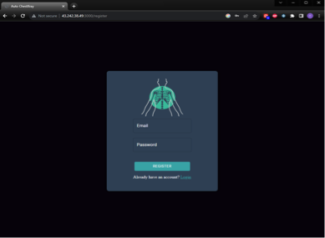
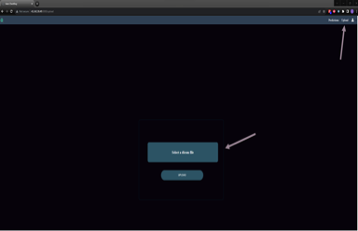
User Registration/Login & Upload Chest X-Ray Image

Slide 6
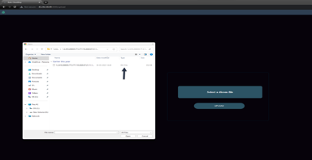
Upload Chest X-Ray Image

Slide 7
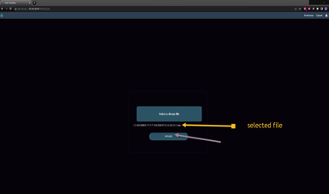
Run AI Models

Slide 8
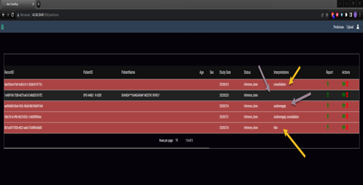
“Prediction Dashboard” Landing Page
First iteration of 3 Pathologies - Cardiomegaly, Consolidation and Hilar prominence completed

Slide 9
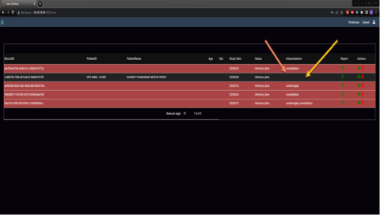
“Prediction Dashboard” Landing Page (To be discussed with Radiologist and Inputs from Animesh)
Colour coding – to ease of reporting/ sorting normal vs pathological chest X-ray
Interpretation present cases highlight as red background
Normal - no background changes

Slide 10
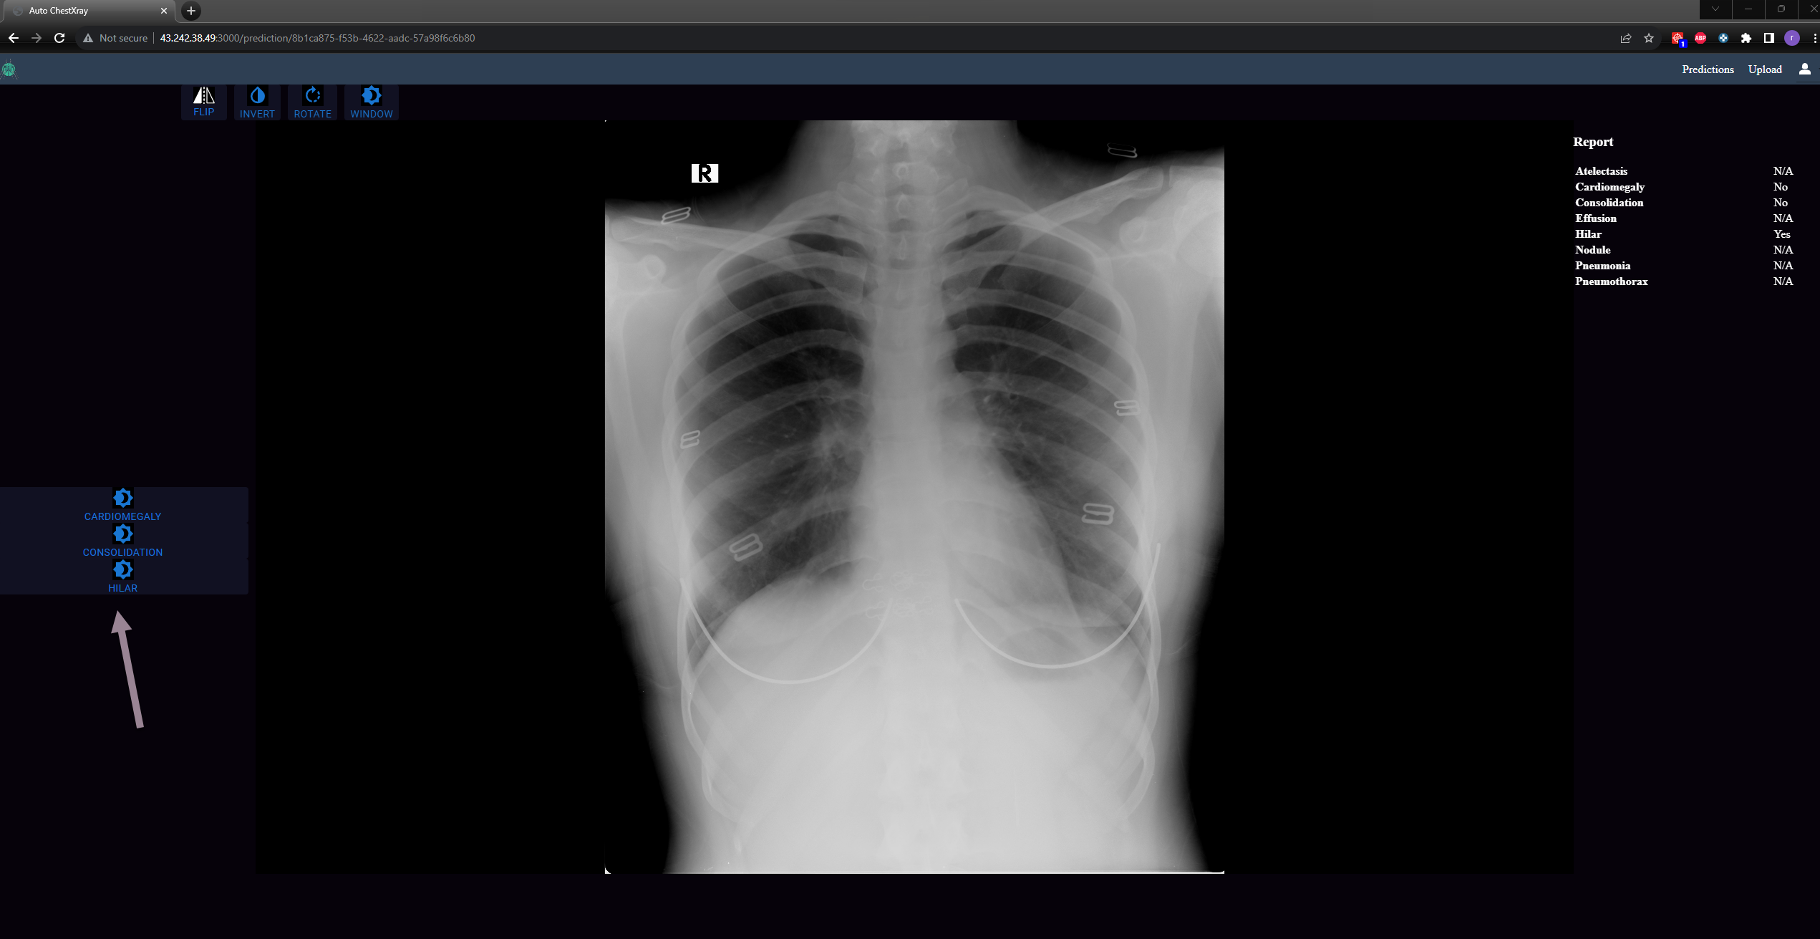
Viewer – With Heat Map “On or Off” Option

Slide 11
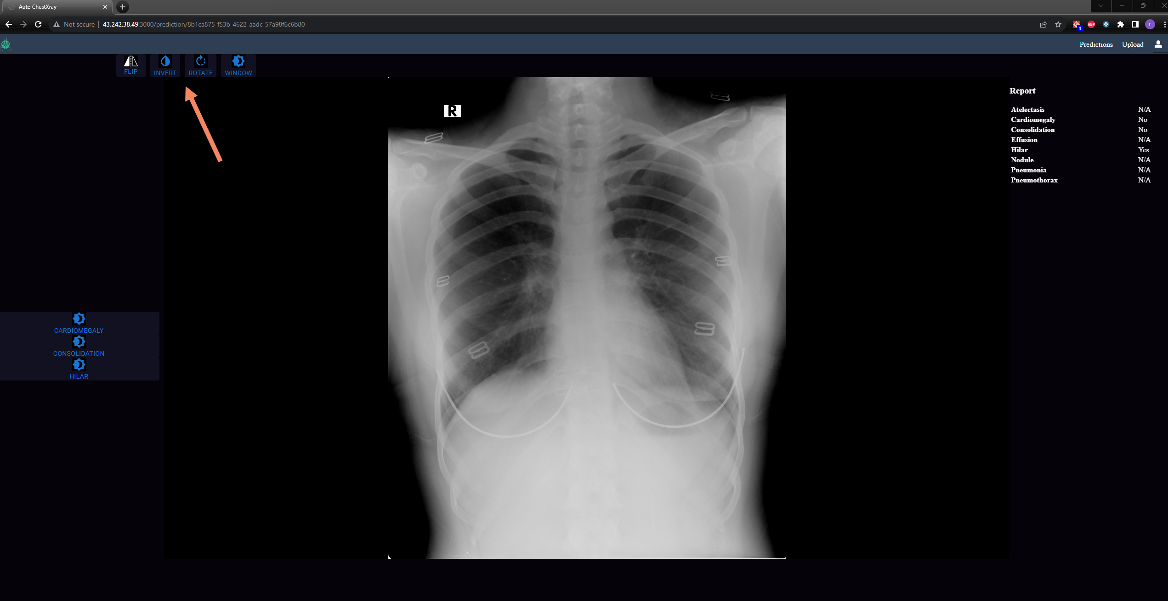
Image viewer tools – Window, Rotation,Flip and Invert

Slide 12
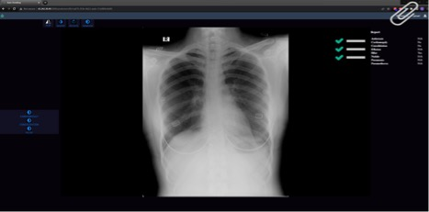
Report at a Glance

Slide 13
Other updates & Next Steps:
Techjiva / VT weekly meeting happening for last 6 weeks (Vivek, Rahim, Premanshu & Animesh)
Demo of 2 Pathology (Cardiomegaly & Consolidation) AI process & output given to Ankit/Kamlesh/Animesh & Vivek
Parallel verification/checking of available AI Outputs (pathologies Completed first Iteration) to be started
One production Server Required
T4 GPU
8/16 Cores
32 GB
Validation and feedback format for parallel Validation under WIP
Inputs on Report format received and same is under WIP
SOW Sign off in progress

